Slide 1
Shri Chhatrapati Shivaji College,OMERGA.
Dr.Suryawanshi V.S.
Asso.Prof.of Chemistry.

Slide 2
Chap.I Rearrangements
1.Beckmann rearrangement
Acid-mediated isomerization of oximes to amides,In protic acid:
Mechanism
the substituent trans to the leaving group migrates

Slide 3
With PCl₅:
Again, the substituent trans to the leaving group migrates
Examples:

Slide 4
Abnormal Beckmann rearrangement is when the migrating fragment (e.g., R¹) departs from the intermediate, leaving a nitrile as a stable product.

Slide 5
Examples:

Slide 6
Pummerer rearrangement
The transformation of sulfoxides into D-acyloxythioethers using acetic anhydride
Examples

Slide 7
Stereoselective Pummerer rearrangement

Slide 8
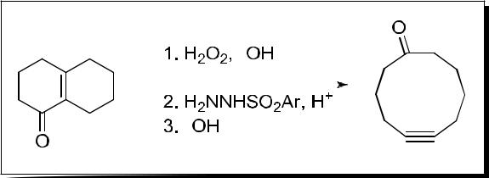
Eschenmoser Tanabe fragmentation
Fragmentation of DE-epoxyketones via the intermediacy of DE-epoxy sulfonylhydrazones
Examples

Slide 10
Payne rearrangement
The isomerization of 2,3-epoxy alcohol under the influence of a base to 1,2-epoxy-3-ol is
referred to as the Payne rearrangement. Also known as epoxide migration
Examples

Slide 11
Aza-Payne rearrangement
Lipase-mediated dynamic kinetic resolution via a vinylogous Payne rearrangement.

Slide 12
Brook rearrangement
Rearrangement of ∆-silyl oxyanions to -∆ silyloxy carbanions via a reversible process involving a pentacoordinate silicon intermediate is known as the [1,2]-Brook rearrangement, or [1,2]-silyl migration.
[1,2]-Brook rearrangement
pentacoordinate silicon intermediate
[1,3]-Brook rearrangement
[1,4]-Brook rearrangement

Slide 13
Examples
[1,2]-Brook rearrangement followed by a retro-[1,5]-Brook rearrangement
[1,5]-Brook rearrangement
Retro-[1,4]-Brook rearrangement
Retro-Brook rearrangement

Slide 14
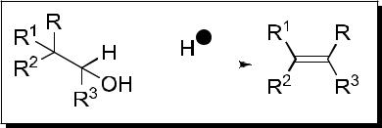
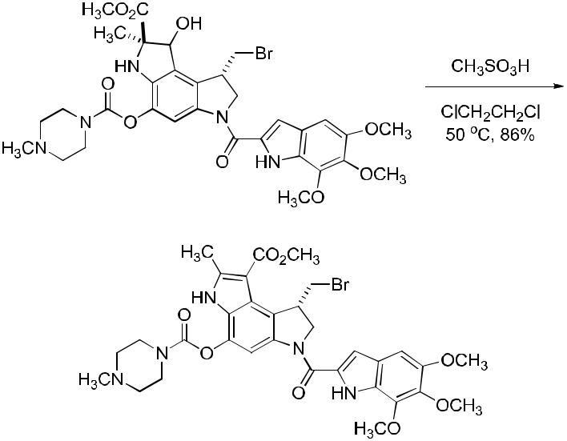
Wagner–Meerwein rearrangement
Acid-catalyzed alkyl group migration of alcohols to give more substituted olefins
Examples

Slide 16
Wolff rearrangement
Conversion of an ∆-diazoketone into a ketene.
Step-wise mechanism:
Treatment of the ketene with water would gives a corresponding homologated carboxylic acid.
Concerted mechanism:
Examples

Slide 17
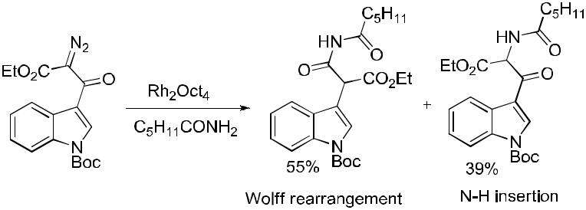

Slide 18
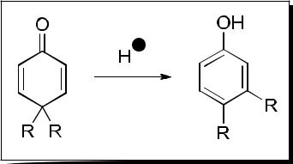
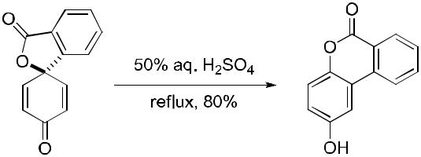
Dienone–phenol rearrangement
Acid-promoted rearrangement of 4,4-disubstituted cyclohexadienones to 3,4-disubstituted phenols.
Examples

Slide 19
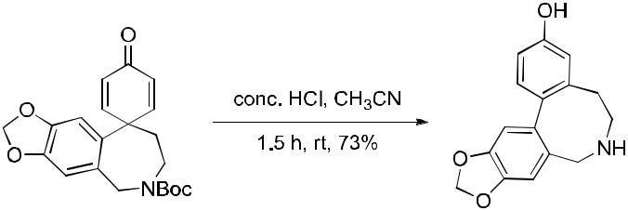
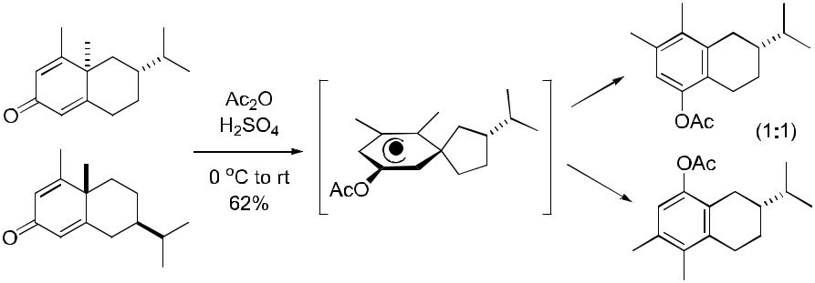

Slide 20
Tiffeneau–Demjanov rearrangement
Carbocation rearrangement of E-aminoalcohols via diazotization to afford carbon-yl compounds through C C bond migration.
Step 1, Generation of N₂O₃
Step 2, Transformation of amine to diazonium salt
N-nitrosonium ion

Slide 21
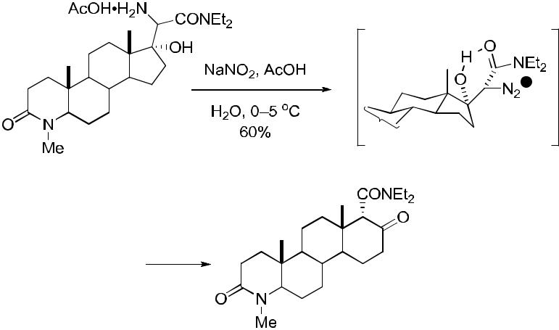
Step 3, Ring-expansion via rearrangement
Examples

Slide 22
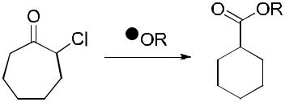
Favorskii rearrangement
Transformation of enolizable α-haloketones to esters, carboxylic acids, or amides via alkoxide-, hydroxide-, or amine-catalyzed rearrangements, respectively.
The intramolecular Favorskii Rearrangement:
enolizable α-haloketone
cyclopropanone intermediate

Slide 23
Examples
Homo-Favorskii rearrangement

Slide 24
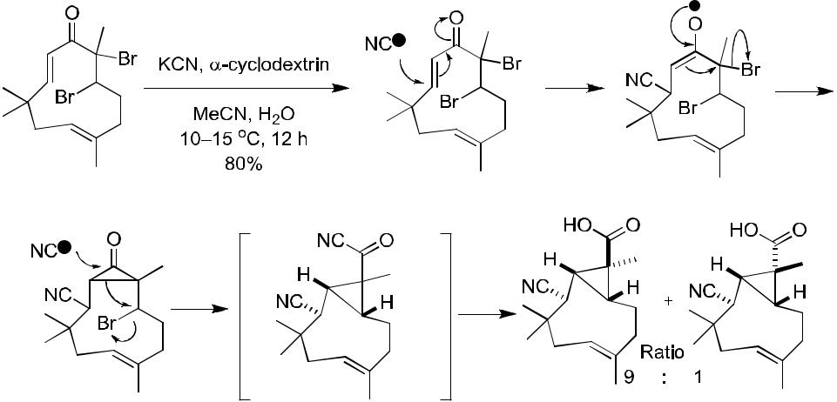
Photo-Favorskii Rearrangement

Slide 25
Wittig reaction
Olefination of carbonyls using phosphorus ylides, typically the Z-olefin is obtained
The “puckered” transition state, irreversible and concerted

Slide 26
Examples

Slide 27
Neber rearrangement
∆-Aminoketone from tosyl ketoxime and base. The net conversion of a ketone into an ∆-aminoketone via the oxime.
ketoxime
∆-aminoketone
Examples
A variant using iminochloride

Slide 28
