Slide 1
SHRI CHHATRAPATI SHIVAJI COLLEGE ,OMERGA DEPARTMENT OF COMPUTER SCI. & IT
CSO19 Data Communication and Networking
CSO19 Data Communication and Networking
Class: B.Sc. VI SEM.
Subject : Computer Sci.(Optional)
Unit-I
Contents
Computer Network
Advantages of Computer Network
Disadvantages of Computer Network
Application of Computer Network
Dr. S.S.Revate
Head and Assistant Professor

Slide 2
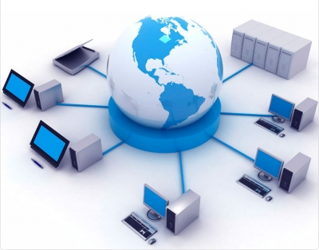
Computer Network :
Definition : A collection of autonomous computers interconnected by a single technology.
Two computers are said to be interconnected if they are able to exchange information. The connection can be via a copper wire; fiber optics, microwaves, infrared, and communication satellites can also be used
A computer network is a set of computers connected together for the purpose of sharing resources.

Slide 3
Advantage of Computer Network :
1.Easy Communication
Communication among people in the business can easily communicate within a computer network.
2. Resource Sharing
Computer network also allows the user to share resources such as printers and faxes. Printer can be installed on one computer and can be accessed by other users in a network.
3. Personal communication :
Email Instantaneous communication e.g.. Email
4. Conferencing :
Tele conferencing, Video conferencing
5. User access control.
Modern networks almost always have one or more servers which allows centralized management for users and for network resources to which they have access.

Slide 4
Disadvantages of Computer Networking
1. Security Concerns Since all computers are linked, the entire network can be put at risk if even just one person comes across a virus or malware application. This can greatly impact the security of sensitive information that pertains to your business.
2. Small Issues Cause Big Problems If there is a problem anywhere in the network, than the entire network is shut down. This could greatly effect productivity because if a single computer is down, then everyone’s ability to work is down as well.
3. Requires A Skilled Manager There are many different things that a person must know about in order to effectively run, manage, and maintain a computer network. This often requires the hiring of an outside person to help keep up with any issue that may occur.

Slide 5
Applications of Computer Networking
1. Resource Sharing:
The goal is to make all programs, equipment's(like printers etc), and especially data, available to anyone on the network without regard to the physical location of the resource and the user.
2. Communication Medium:
A computer network can provide a powerful communication medium among employees. Virtually every company that has two or more computers now has e-mail (electronic mail), which employees generally use for a great deal of daily communication
3. E -Commerce:
A goal that is starting to become more important in businesses is doing business with consumers over the Internet. Airlines, bookstores and music vendors have discovered that many customers like the convenience of shopping from home.
4) Data Sharing
It is the capability of sharing data with multiple users over the network. In order to share the data among multiple users, it is generally stored on servers. Different applications can therefore access the data from these servers easily. A special software locking mechanism is maintained over the network, so as to prevent multiple users from modifying the data. The sharing of data among the multiple users in an interactive way is known as data conferencing.
5) Remote Data Access
Remote data access is the process of accessing the data from remote location in an efficient way. Different software programs are used to provide an interface to the end users for accessing the data remotely.

Slide 6
References:
http://ceng.tu.edu.iq/eed/images/Computer_Communication_Networks-1.pdf
https://navajocodetalkers.org/9-advantages-and-disadvantages-of-computer-networking/

