Slide 1
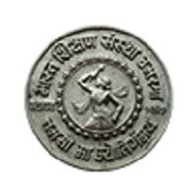
SHRI CHHATRAPATI SHIVAJI COLLEGE , OMERGA
“Operating System”
Paper Code : CS-04
Prepared by
Mrs. Nitnaware Reshma Ramdas
Asst. Prof. in Computer Science

Slide 2
Operating System
An operating system (OS) is system software that manages computer hardware and software resources and provides common services for computer programs.
An operating system is a program that acts as an interface between the software and the computer hardware.
It is an integrated set of specialized programs used to manage overall resources and operations of the computer.
It is a specialized software that controls and monitors the execution of all other programs that reside in the computer, including application programs and other system software.

Slide 3

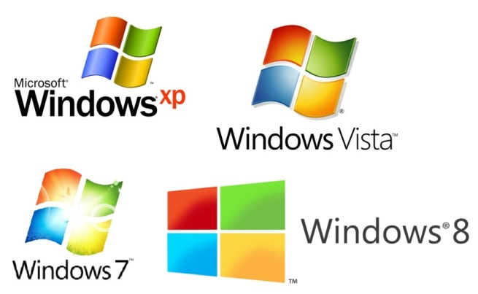
Operating System
Operating System
COMPUTER
USER

Slide 4
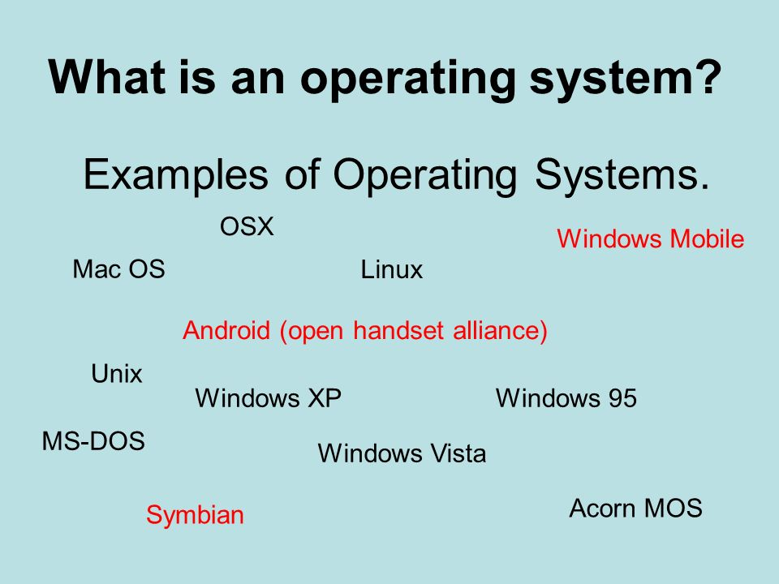

Slide 5
functions of an operating System.
Memory Management
Processor Management
Device Management
File Management
Security
Control over system performance

Slide 6
Advantages :
Allocating memory is easy and cheap
Any free page is ok, OS can take first one out of list it keeps
Eliminates external fragmentation
Data (page frames) can be scattered all over PM
Pages are mapped appropriately anyway
Allows demand paging and prepaging
More efficient swapping
No need for considerations about fragmentation
Just swap out page least likely to be used

Slide 7
Disadvantages :
Longer memory access times (page table lookup)
Can be improved using TLBGuarded page tables
Inverted page tables
Memory requirements (one entry per VM page)
Improve using Multilevel
page tables and variable page sizes (super-pages)
Guarded page tables
Page Table Length Register (PTLR) to limit virtual memory size
Internal fragmentation

Slide 8
TYPES OF OPERATING SYSTEM

Slide 9
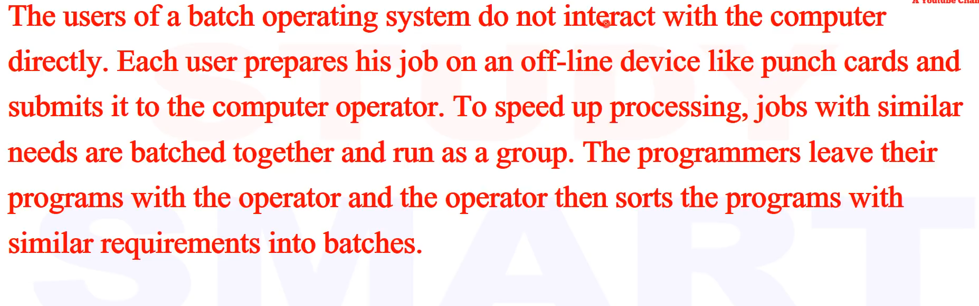
BATCH OPERATING SYSTEM
The problems with Batch Systems are as follows −
Lack of interaction between the user and the job.
CPU is often idle, because the speed of the mechanical I/O devices is slower than the CPU.
Difficult to provide the desired priority.

Slide 10
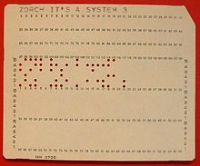
A punched card or punch card is a piece of stiff paper that can be used to contain digital data represented by the presence or absence of holes in predefined positions.
A punch card is a simple piece of paper stock that can hold data in the form of small punched holes, which are strategically positioned to be read by computers or machines. It is an early computer programming relic that was used before the many data storage advances relied upon today.

Slide 11
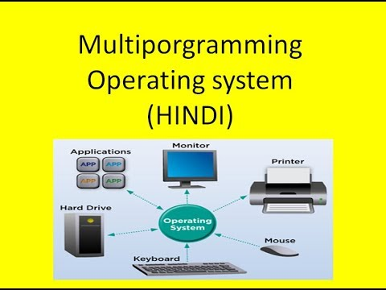
Multiprogramming Operating System
A multiprogramming operating system is one which can run multiple programs(or processes) concurrently. A multiprogramming operating system needn’t be multiprocessing, it could be round robin based system that allows each process to execute only for a certain period of time and then puts it into the ready queue. A multiprocessing system is one which has multiple processing cores. At any point of time only a single core is active and executing one of the processes(or threads).

Slide 12
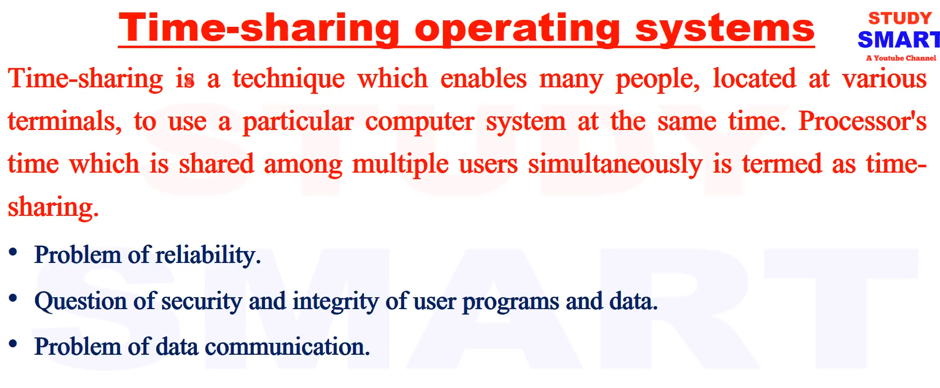
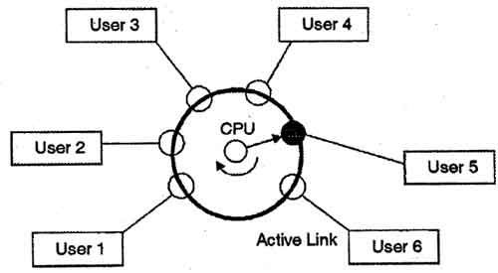

Slide 13
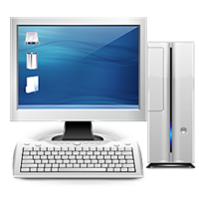
Personal Computer (PC)
A personal computer is a general-purpose, cost-effective computer that is designed to be used by a single end-user. Every PC is dependent on microprocessor technology, which allows PC makers to set the entire central processing unit (CPU) on a single chip.
Businesses make use of PCs to perform tasks like accounting, desktop publishing and word processing as well as to run database and spreadsheets. At home, PCs are mainly used for multimedia entertainment, playing PC games, accessing the Internet, etc. Even though PCs are intended to use as single-user systems, it is normal to connect them together to create a network, such as a local area network (LAN).
A PC can be a microcomputer, desktop computer, a laptop computer, a tablet PC or a handheld PC.

Slide 14
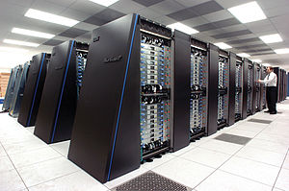
Parallel operating systems
Parallel Processing Systems are designed to speed up the execution of programs by dividing the program into multiple fragments and processing these fragments simultaneously. Such systems are multiprocessor systems also known as tightly coupled systems.
Parallel systems deal with the simultaneous use of multiple computer resources that can include a single computer with multiple processors, a number of computers connected by a network to form a parallel processing cluster or a combination of both.
Parallel computing is an evolution of serial computing where the jobs are broken into discrete parts that can be executed concurrently.

Slide 15
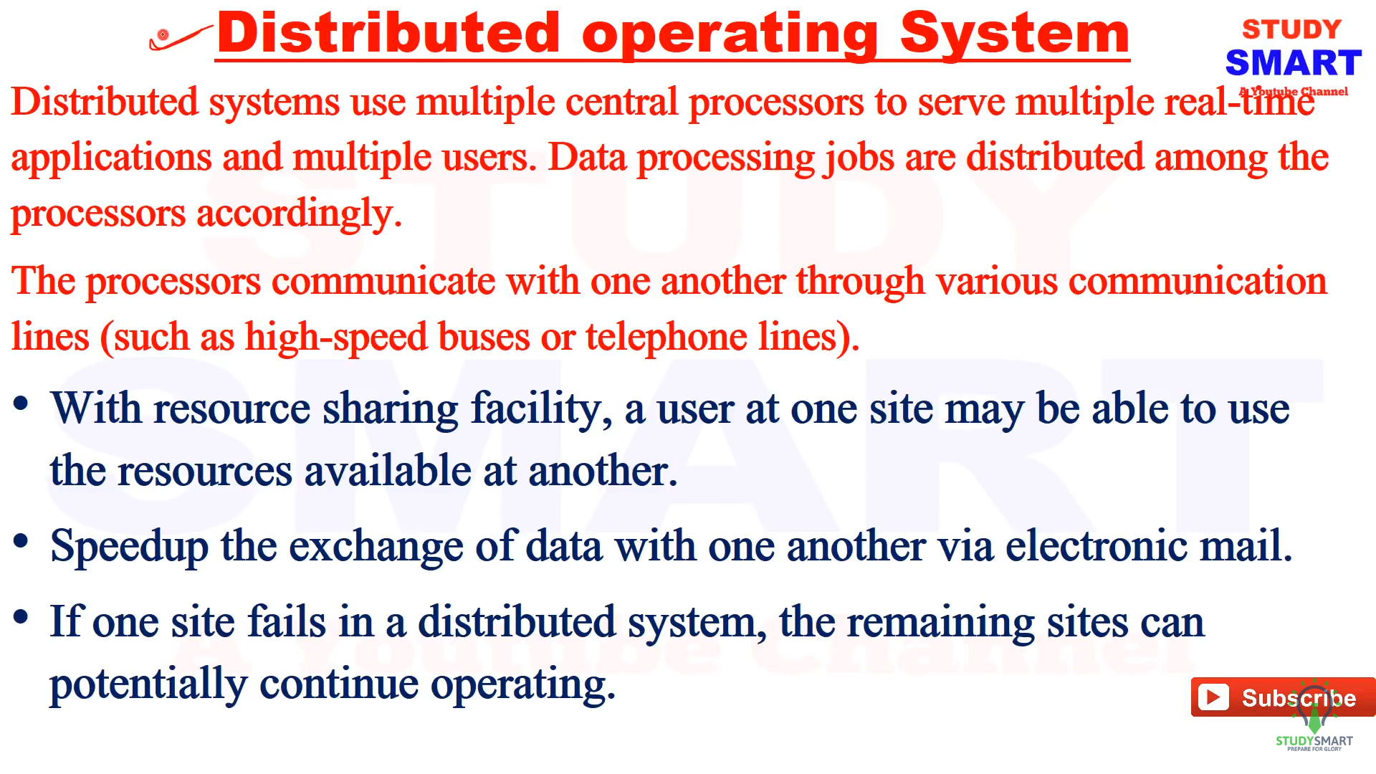

Slide 16
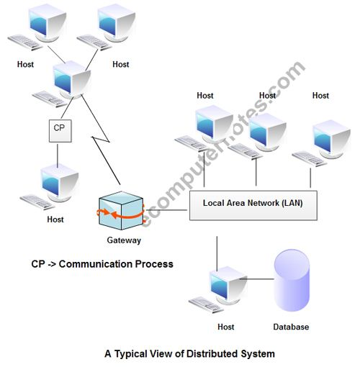

Slide 17
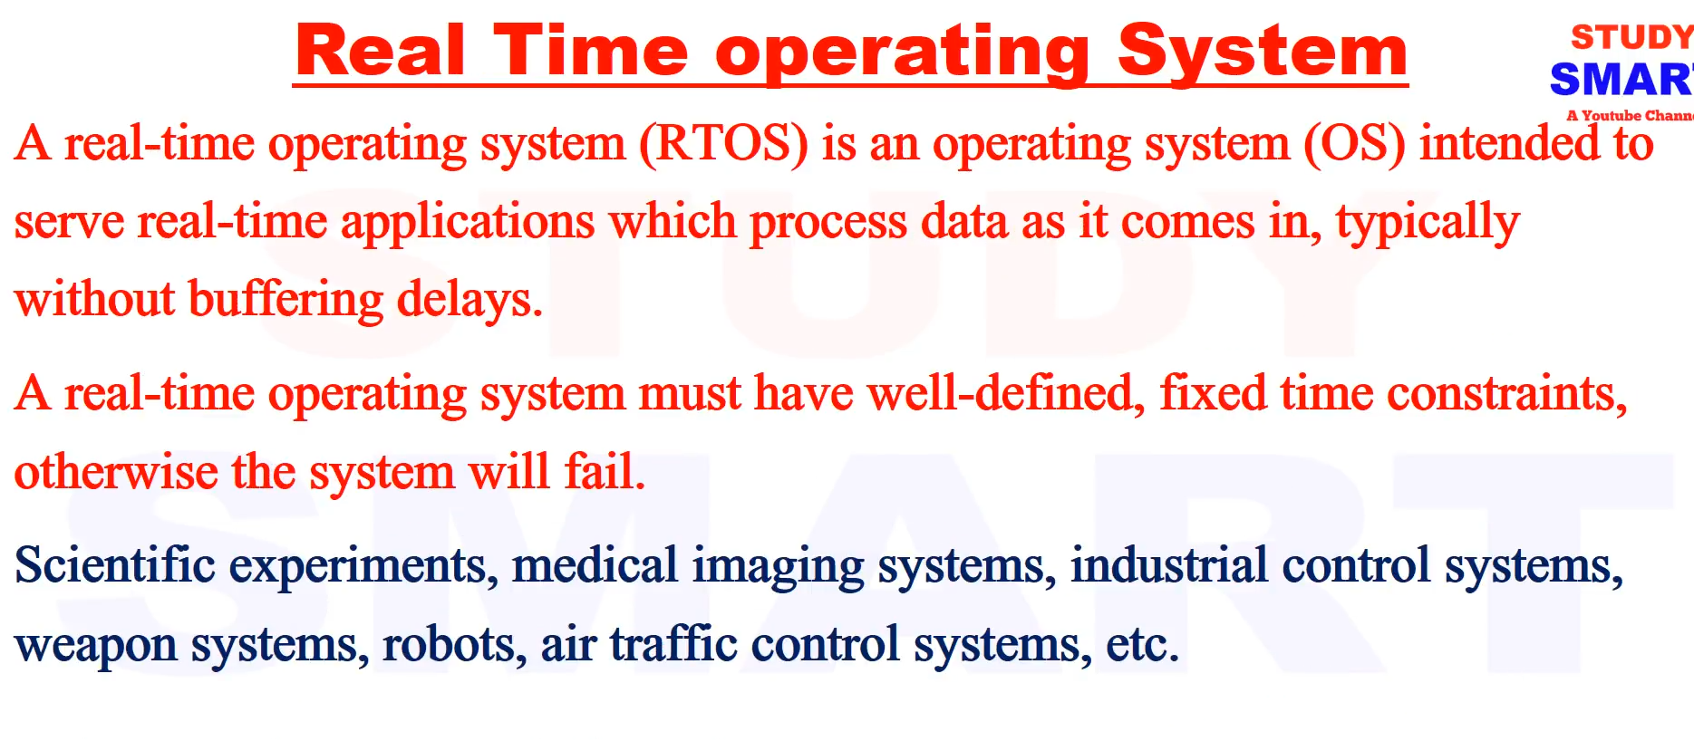
Hard real-time systems :- Hard real-time systems guarantee that critical tasks complete on time. In hard real-time systems, secondary storage is limited or missing and the data is stored in ROM. In these systems, virtual memory is almost never found.
Soft real-time systems :- Soft real-time systems are less restrictive. A critical real-time task gets priority over other tasks and retains the priority until it completes. Soft real-time systems have limited utility than hard real-time systems. For example, multimedia, virtual reality, Advanced Scientific Projects like undersea exploration and planetary rovers, etc.

Slide 18
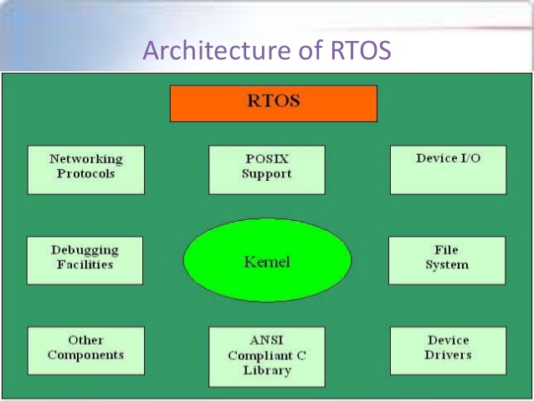

Slide 19
Tomorrow will cont…

Slide 20
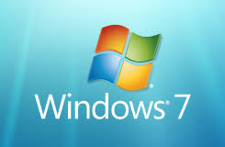

Slide 21
WINDOWS 7
Windows 7 is a personal computer operating system that was produced by Microsoft as part of the Windows NT family of operating systems. It was released to manufacturing on July 22, 2009 and became generally available on October 22, 2009
Windows NT is a family of operating systems developed by Microsoft that featured multi-processing capabilities, processor independence and multi-user support.

Slide 22
Advantages:
Windows 7 is more rapidly than its predecessors, each with regards to installation and boot up time.
Microsoft facilitates in windows 7, to download some eye-catching themes and background pictures from its personal Microsoft site or from RSS (Really Simple Syndication) feed. It permits the user to customize each and every part of the themes and save for our future use or send for the other windows 7 customers.
Windows Media Player 12 has got a lot enhanced attributes inside the Windows 7 and drag and drop alternative has been added which had been not there inside the earlier versions.
Windows 7 is a lot more stable than Windows Vista. In other words, you'll find fewer crashes on Windows 7.
7 is more rapidly than Vista, and in most circumstances, more rapidly than XP.
7 features a large amount of new and really great attributes that are not in other versions.
7 looks great, is developed for touch screen interaction (every little thing is bigger by default)

Slide 23
Disadvantages
1.A number of the customers have difficulties for example; their technique hangs right after installing Windows 7
2.In the event the user has got an HP multifunction printer, and its driver getting upgraded for the Windows 7, then the printer doesn't response for the print commands. So, the user wants to go to the new HP remedy Center to resolve this difficulty.

Slide 24
Installation Window 7
https://www.wikihow.com/Install-Windows-7-(Beginners)

Slide 25
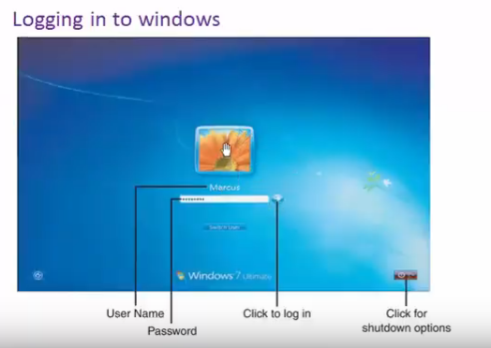

Slide 26
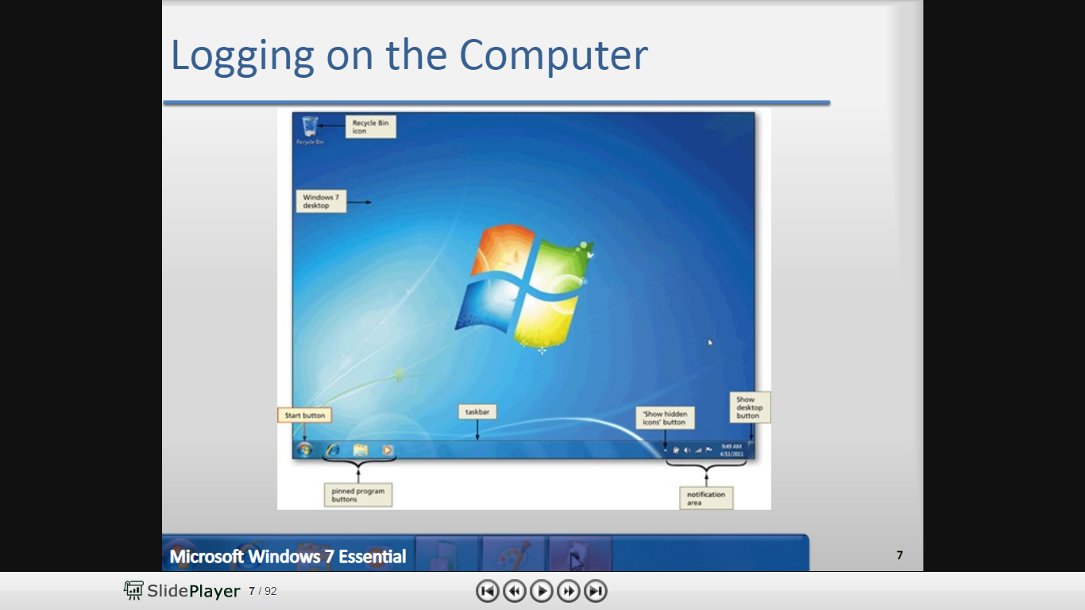
Start Window 7

Slide 27
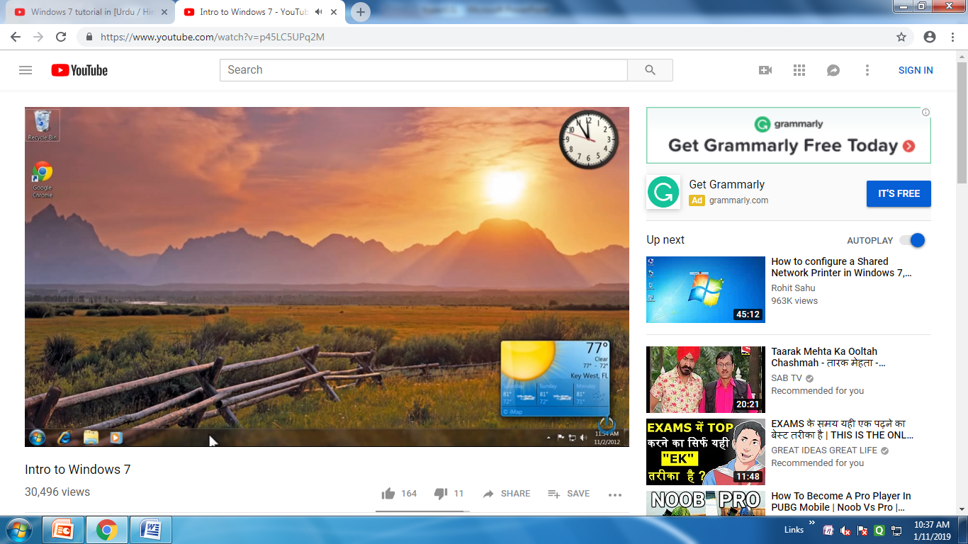

Slide 28
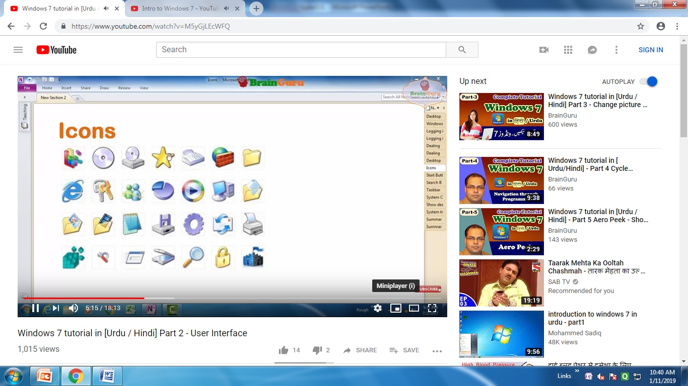

Slide 29
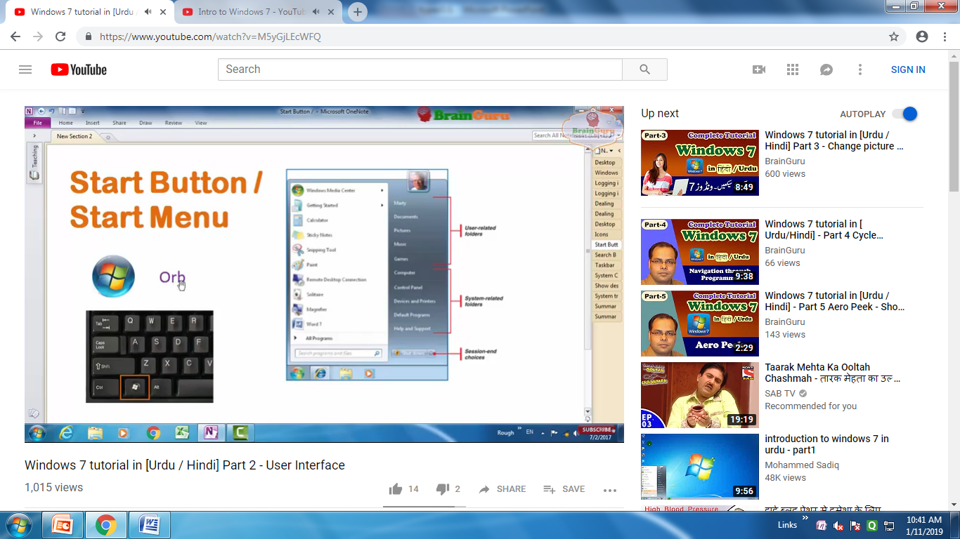

Slide 30
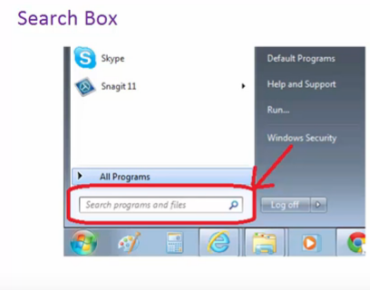

Slide 31
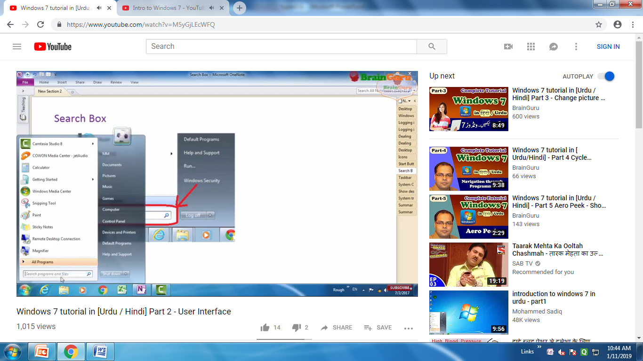

Slide 32
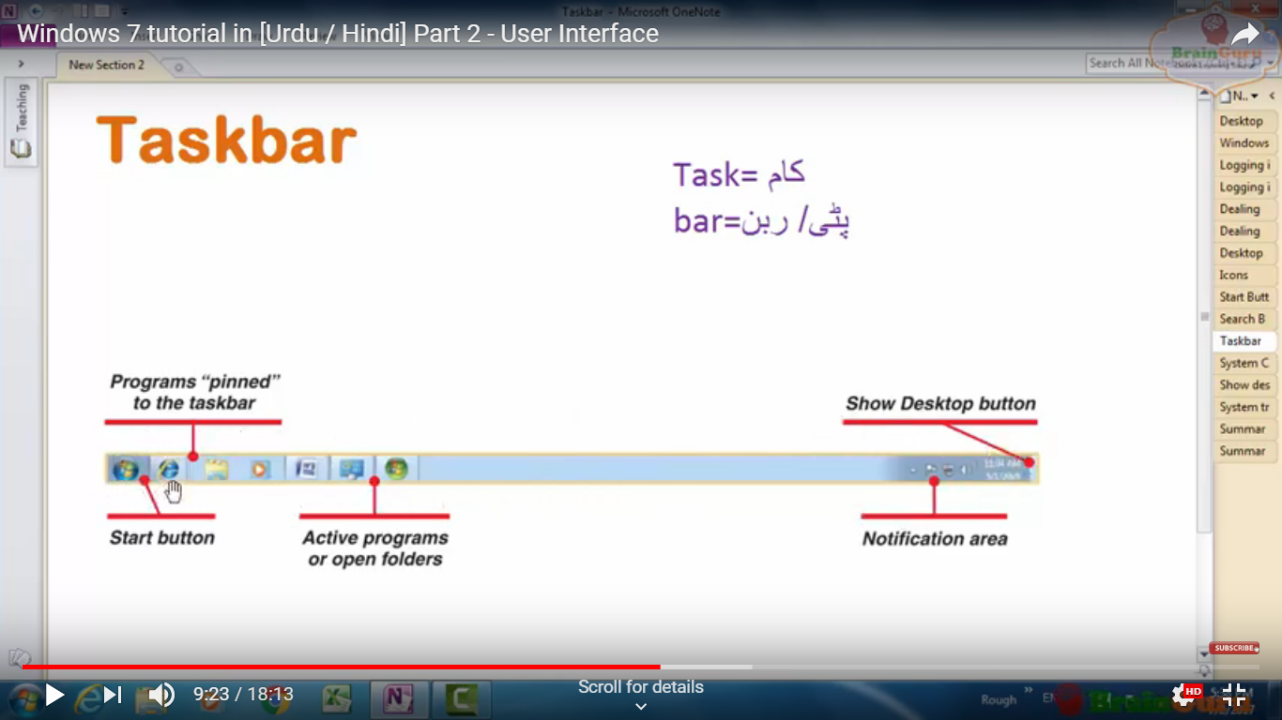

Slide 33
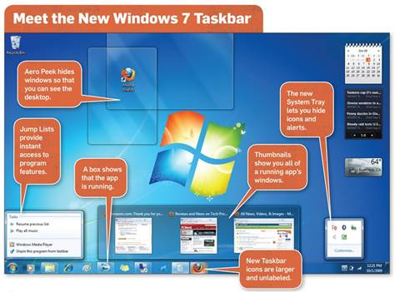

Slide 34
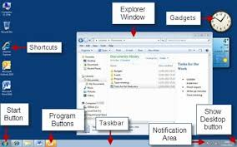

Slide 35
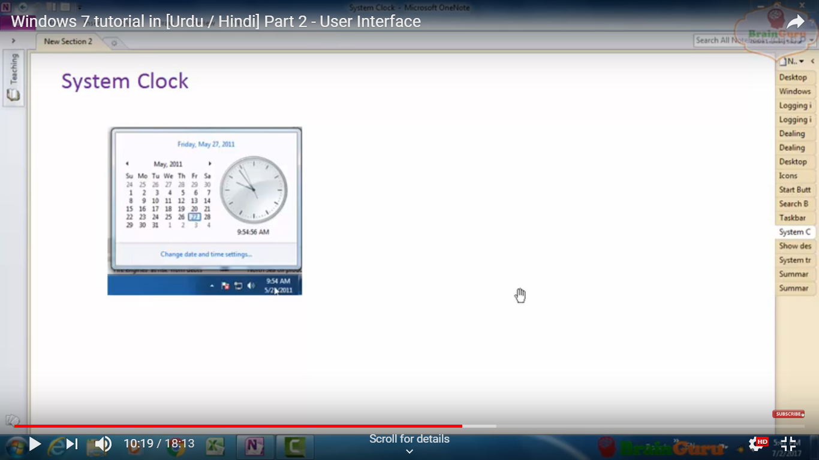

Slide 36
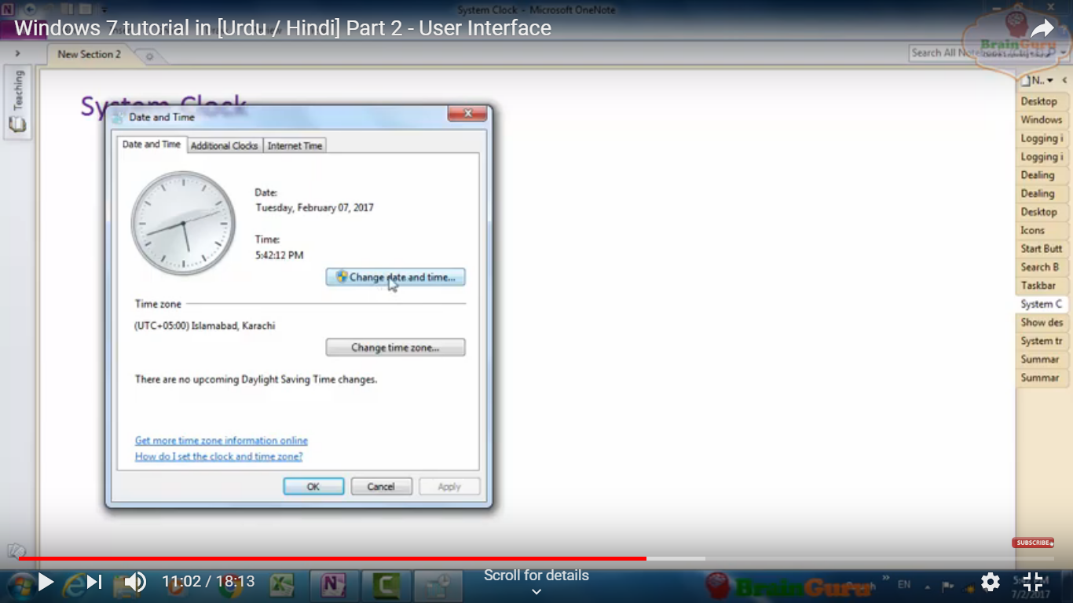

Slide 37
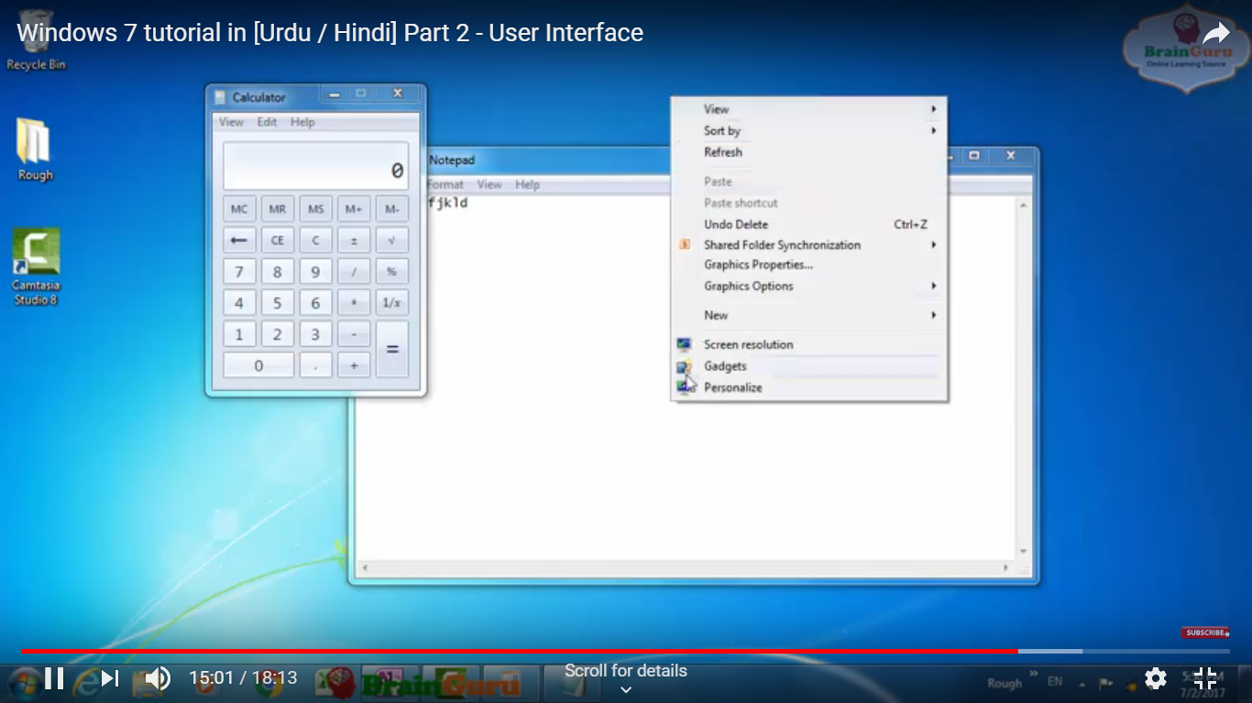

Slide 38
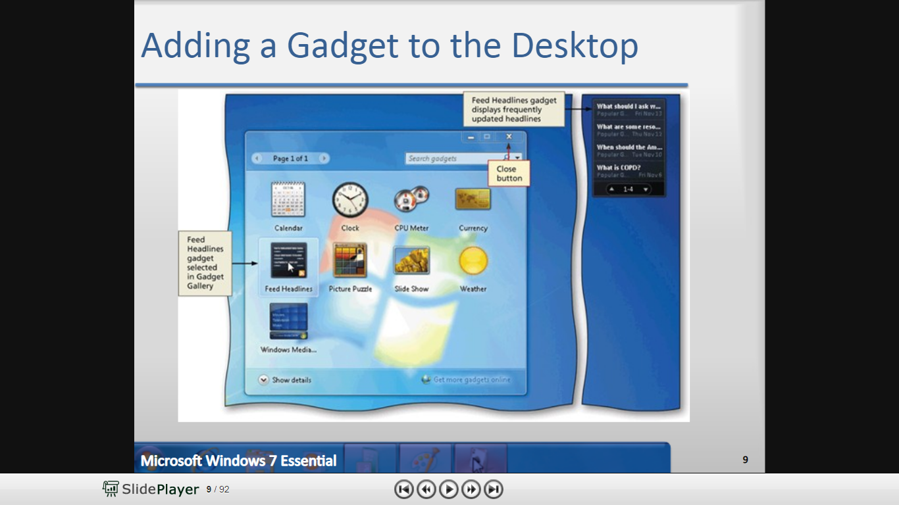

Slide 39
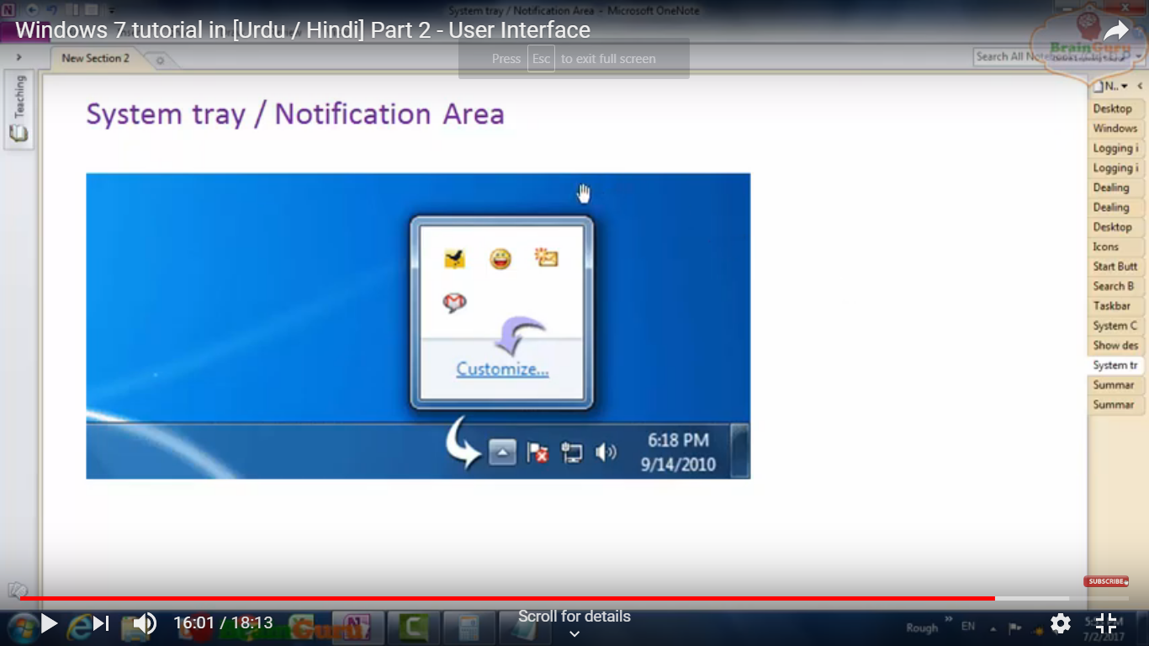

Slide 40
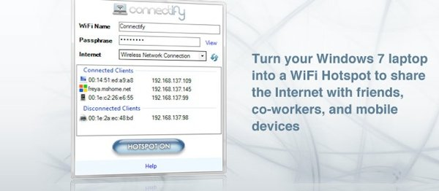

Slide 41
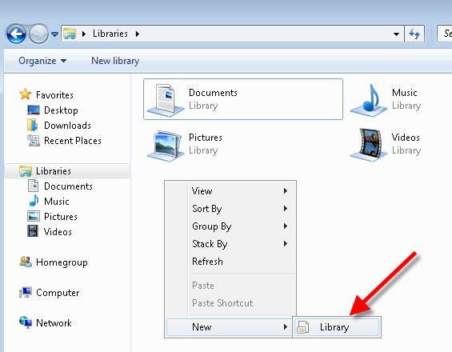
Windows 7 Libraries is that you can create your own libraries. How do you do it? Easy. In explorer view, just go to your Libraries, right-click, then click on New -Library.

Slide 42
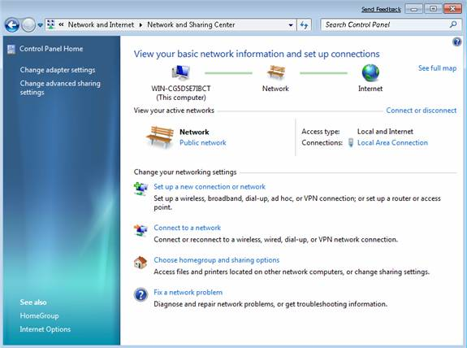
In Windows 7 the Network and Sharing center has been simplified.

Slide 43
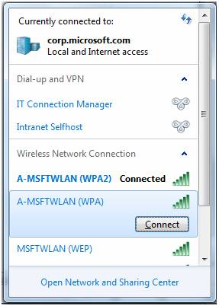
View Available Networks (VAN)

Slide 44
And So on ……..
Its More Features Present in Windows 7

Slide 45
Thanku

Slide 46
Tutorials Questions
Q.1 . Explain Installation Steps For Windows 7 ?
Q.2. Explain Taskbar Details ?
Q.3. Write Down Steps for Changing Date and Time.

Slide 47
https://player.slideplayer.com/24/7353057/#

Slide 48
Tutorial Point
https://www.free-computer-tutorials.net/windows-7-desktop.html

