Slide 1
Presentation 3: What is nano?

Slide 2
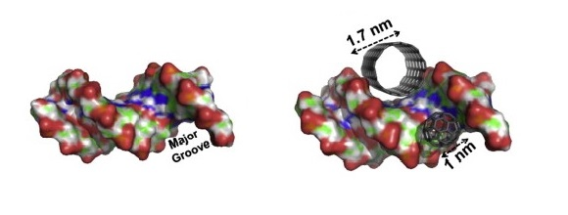
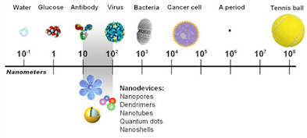
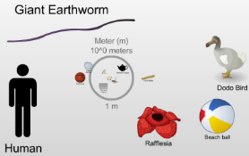
What is nano?
Nanotechnology is science, engineering, and technology conducted at the nanoscale (about 1 to 100 nanometers)
Nano can refer to technologies, materials, particles, objects – we are focusing on nanomaterials as these are already being used in workplaces more widely
A sheet of paper is about 100,000 nanometers thick, a human hair is around 80,000- 100,000 nanometers wide
The Scale of the Universe video
Human hair and a sheet of paper
References:
http://www.cancer.gov/researchandfunding/snapshots/nanotechnology
http://www.nano.gov/nanotech-101
Yanamala N, Kagan VG and Shvedova AA (2013), Adv. Drug Del. Rev. 65, 2070-2077. "Molecular modeling in structural nano-toxicology: Interactions of nano-particles with nano-machinery of cells".
Date, location

Slide 3
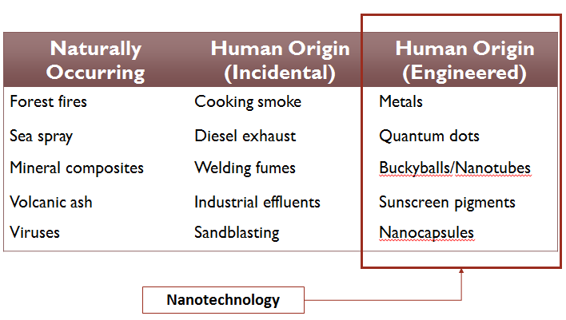
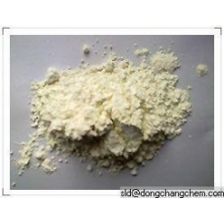
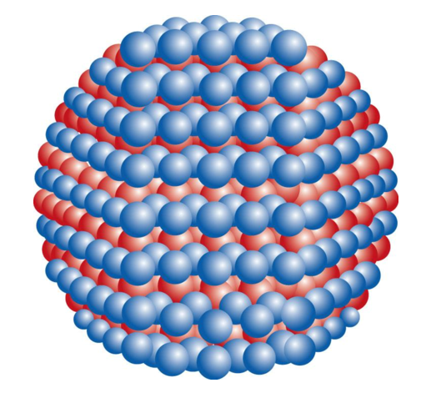
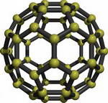
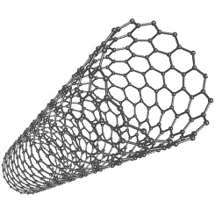
Types of nanomaterials
Nanomaterials can…
occur naturally
be produced by human activity either as a product of another activity
on purpose (engineered)
Our focus: engineered nanomaterials as these are designed and integrated into products because of the specific characteristics of the nanomaterial
References:
https://nanohub.org/groups/gng/training_materials (Introduction to Nanomaterials and Occupational Health)
Images:
http://www.everychina.com/m-rubber-nano-zinc-oxide
http://img.docstoccdn.com/thumb/orig/76747818.png
http://www.nanodic.com/carbon/Fullerene/1_resize.jpg
http://www.carbonallotropes.com/39-122-thickbox/single-wall-carbon-nanotubes.jpg
http://www.icbpharma.pl/techno_slow.html
Date, location

Slide 4
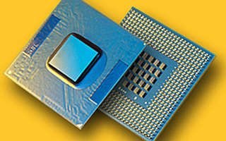
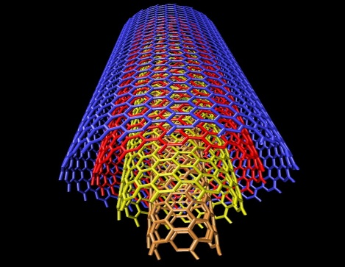
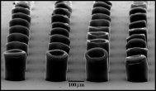
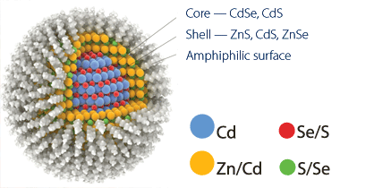
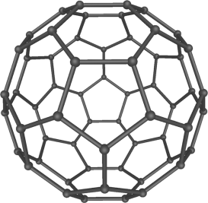
Different approaches to nanotechnology
Nanotechnologies can be:
Top-down
Etching a block of material down to the desired shape
Chips and processors
Bottom-up
Building materials atom by atom - like lego
Nanoparticles such as C₆₀, carbon nanotubes, quantum dots
Images:
Provided by Steffen Foss Hansen, Danish Technical University, except C60 image from https://en.wikipedia.org/wiki/Fullerene and quantum dot from http://en.rusnano.com/upload/OldNews/Files/33619/current.gif
Date, location

Slide 5
Classes of nanomaterials
References:
Hansen et al. 2007. Nanotoxicology 1:243-250 and http://www.risk-trace.com/portugal2008/lectures/FossHansen.pdf
Date, location

Slide 6
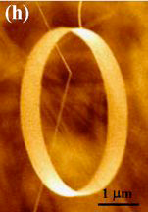
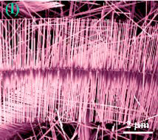
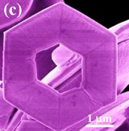
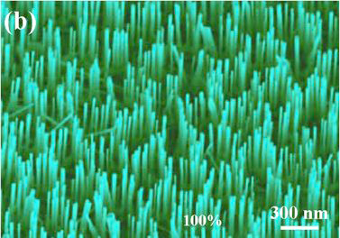
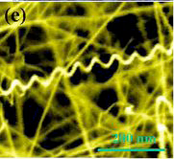
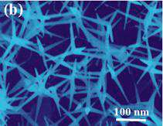
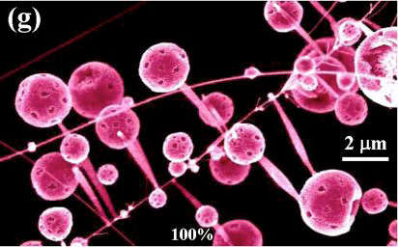
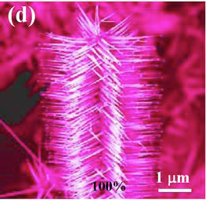
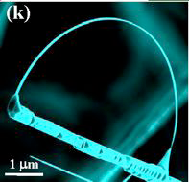
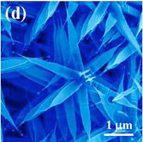
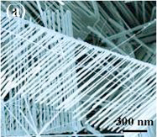
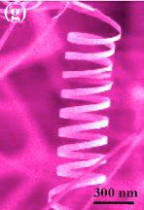
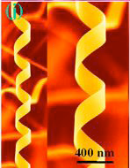
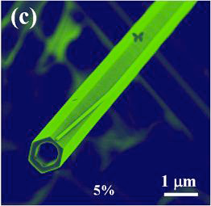
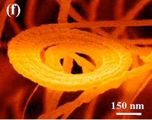
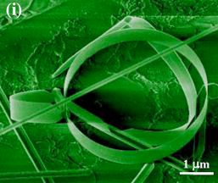
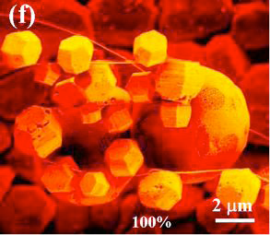
NanoZnO – One Chemistry, Many Shapes
Courtesy of Prof. Z.L. Wang, Georgia Tech

Slide 7
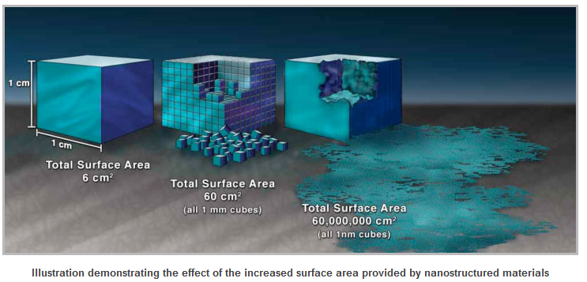
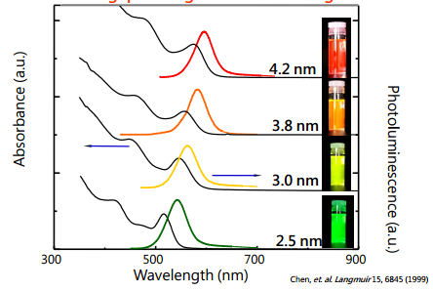
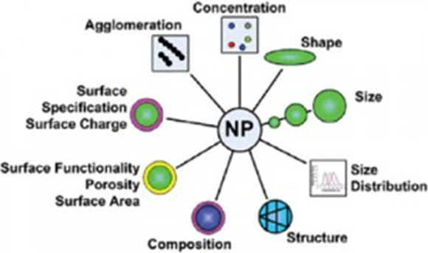
Why are nanomaterials used?
At nano-scale,
the material properties change - melting point, fluorescence, electrical conductivity, and chemical reactivity
Surface size is larger so a greater amount of the material comes into contact with surrounding materials and increases reactivity
Nanomaterial properties can be ‘tuned’ by varying the size of the particle (e.g. changing the fluorescence colour so a particle can be identified)
Their complexity offers a variety of functions to products
References:
http://www.nano.gov/nanotech-101
Image:s :
http://www.nano.gov/nanotech-101/special
http://www.phys.sinica.edu.tw/TIGP-NANO/Course/2012_Fall/classnotes/NanoB_PART_I_20121101.pdf
http://nanocomposix.com/pages/nanotoxicology-particle-selection
Date, location

Slide 8
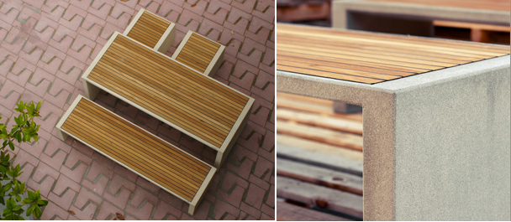
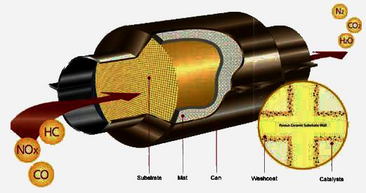
Examples of nanomaterials in products
Examples:
Amorphous silica fume (nano-silica) in Ultra High Performance Concrete – this silica is normally thought to have the same human risk factors as non‐nano non‐toxic silica dust
Nano platinum or palladium in vehicle catalytic converters - higher surface area to volume of particle gives increased reactivity and therefore increased efficiency
Crystalline silica fume is used as an additive in paints or coatings, giving e.g. self-cleaning characteristics – it has a needle-like structure and sharp edges so is very toxic and is known to cause silicosis upon occupational exposure
References:
http://www.efbww.org/pdfs/Nano.pdf
http://www.landscapeforms.com/en-US/site-furniture/Pages/prima-marina-table.aspx
http://www.nano.gov/nanotech-101/special
http://old.vscht.cz/monolith/
http://www.efbww.org/pdfs/Nano.pdf
Date, location

Slide 9
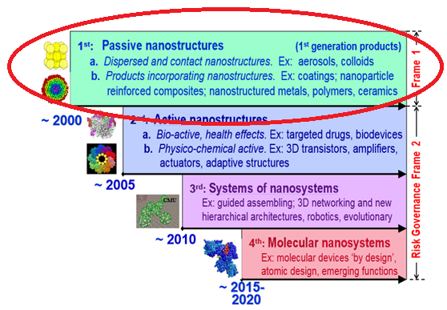
Nano now and in the future
In 2004, a scientist working in the US proposed 4 generations of nanotechnologies, with the 1st generation already existing: nanomaterials
1st generation generally combines a nanomaterial with another material to introduce a new functionality or enhance performance/behaviour
Increasing complexity and ethical issues
Generational timeline was optimistic
References:
Mihael Roco: http://irgc.org/IMG/pdf/Mike_Roco_Risk_Governance_for_Nanotechnology_-_An_Introduction_to_Frame_2_.pdf
Woodrow Wilson Institute Oversight of Next-Generation Nanotechnology (http://www.nanotechproject.org/process/assets/files/7316/pen-18.pdf)
Date, location

