Slide 1
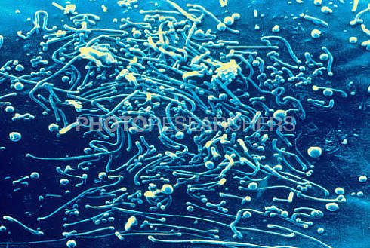
Mycoplasma
Dr. Shinde A. S.
Department of Botany
Shri Chhatrapati Shivaji College,Omerga

Slide 2
Classification & General Characteristics
Family : Mycoplasmaceae
Genus : Mycoplasma
Species : Mycoplasma pneumoniae Mycolplasma hominis Ureaplasma urealyticum
General Genus Characteristics
Small, prokaryotic organisms w/ NO PG cell walls
Enclosed in a single, trilaminar plasma membrane
Composed of a lipid bilayer
Classified as plastic and pleomorphic
Smallest of known free-living, self-replicating prokaryotic cells
Frequently pass thru bacteriologic filters
Widely distributed in nature, including normal flora of mouth and genitourinary tract of humans and other mammals
Insensitive to antibiotics that inhibit cell division by preventing cell wall synthesis

Slide 3
General Characteristics
General Genus Characteristics
Limited biosynthetic capabilities
Require small, organic molecules for growth
Contain sterols in cell membranes
Require external source of cholesterol
Medically important species are facultative anaerobes
Laboratory setting: production of small colonies on specialized agar after 3-4 days
Central portion – penetrates the agar
Periphery spreads to adjacent surfaces
“fried-egg” appearance

Slide 5
Mycoplasma pneumoniae
Etiological agent for disease known as Primary Atypical Pneumonia (“Walking Pneumonia”)
Lower respiratory tract infection
Mode of Transmission: person-to-person via respiratory droplets
Epidemiology: worldwide distribution, year-round infection w/ ↑ incidence in late fall and winter
Cases usu. sporadic; epidemics do occur – among individuals in close contact: schools, prisons, military populations.
Highest incidence = older children, young adults (6-20 yoa)

Slide 7
Mycobacteria
Genus : Mycobacterium
Species : Mycobcaterium tuberculosis Mycobacterium bovis Mycobcaterium avium-intracellulare (MOTT or Atypicals) Mycobacterium leprae
General Genus Characteristics
Mycobacteria have a high lipid content
Cell wall is a complex layered complex: Gram (+) w/ a lot of Lipid
PG skeleton overlayed w/ layers of Lipid (fat)
1° lipid = Mycolic Acid
Lipid accounts for 40-60% of dry wt. of cell
Cell wall composition responsible for distinguishing traits
Acid fastness
Slow growth
Resistance to disinfectants, stains, and common antibiotics; also corrosive action of strong acids & alkalis; drying, but not heat &UV rad
Antigenicity – surface glycolipids

Slide 8
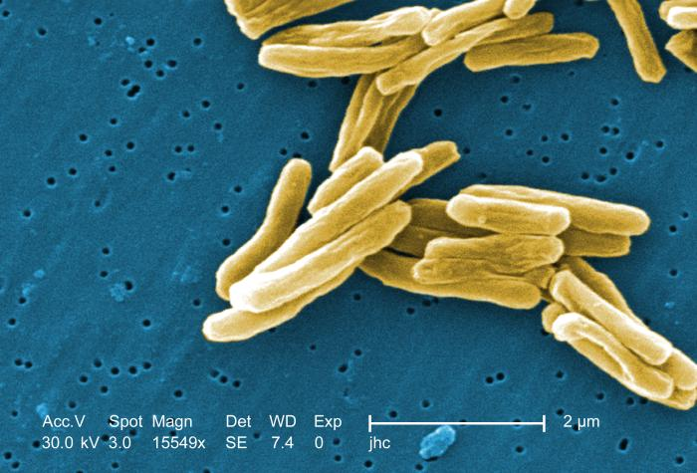
Mycobacterium tuberculosis

Slide 9
General Characteristics
General Genus Characteristics
Acid-Fast Bacilli
Ziehl-Neelsen Procedure: acid fast stain (Carbol-fuchsin) is forced by heat or detergent into the cell
Bacterium resists acid alcohol decolorization & retains RED color of acid fast stain
NOT able to be stained by Gram stain reagents
Waxy cell surface makes bacterium strongly hydrophobic
Slow Growth Rate
Generation time = 18-24 hours; compare E. coli @ 30 min
Slow growth rate d/t lipid-rich cell wall

Slide 10
Mycobacterium tuberculosis …is Aerobic

Slide 11
Clinical
Tubercle Bacilli – Tuberculosis
Etiological agents
Mycobacterium tuberculosis (Human strain)
Mycobacterium bovis (found in cattle only)
Epidemiolgy
Transmission: close person-to-person contact via inhalation of infectious aerosols (shed by coughing)
Organisms remain viable in the environment for a long time d/t resistance to dessication
Single infected person can pass organism to others in an exposed group: family, classroom, hospital ward.
High Rates of Infection
Homeless, recent immigrants, drug addicts, AIDS pts
Nosocomial transmission – AIDS pts or multi-drug resistant TB

