Slide 1
Lichen & Its Importance
Dr. Shinde A. S.
Head, Department of Botany
Shri Chhatrapati Shivaji college, Omerga

Slide 2
What Is a Lichen?
Lichens are made up of two different organisms living together:
A fungus and an alga.
The fungus provides the body in which the alga can live protected from light and drought.
The alga makes the food for the fungus.

Slide 3
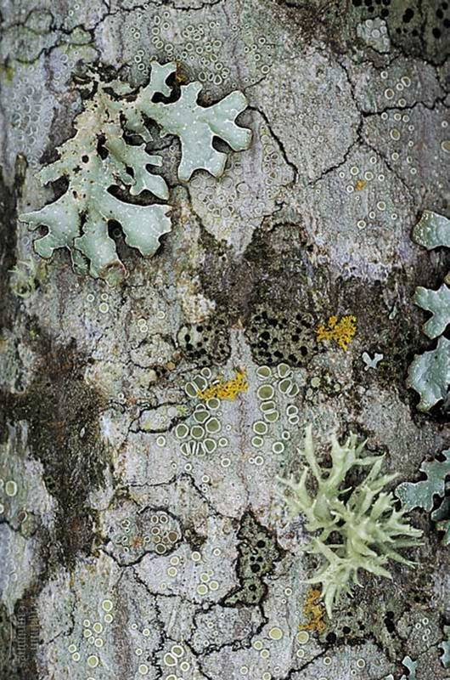
What is Lichen
“Mutualism” between
  Fungus – structure
  Alga or cyanobacterium – provides food
  Crustose lichens form flat crusty plates.
  Foliose lichens are leafy in appearance, although lobed or branched structures are not true leaves.
  Fruticose lichens are even more finely branched and may hang down like beards from branches or grow up from the ground like tiny shrubs.

Slide 4
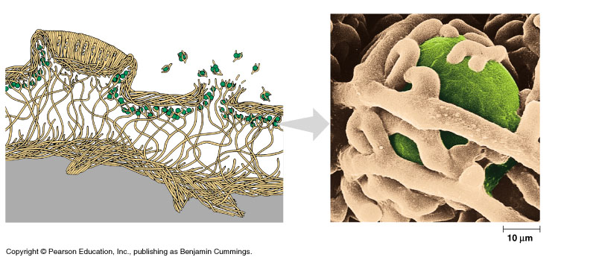
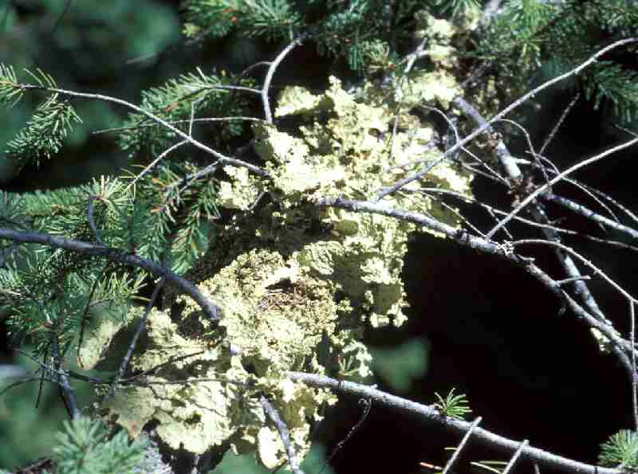
Lichen internal structure
Lichens are nature’s biological monitors of pollution and air quality
  Thalli act like sponges
  Some species more sensitive to pollution
  Which species are present can indicate air quality
  Most resistant species can also be analyzed for pollutants, including bioaccumulation of heavy metals and radioactive isotopes

Slide 5
Lichen as Air Pollution Indicators

Slide 6
Lichens as Air Pollution Indicators
There are many types of air pollution:
Smoke from chimneys
Car fumes
Dust and fertiliser from fields
Fumes from factories and power stations
All of these types of air pollution contain NITROGEN – many lichens do not like too much NITROGEN.

Slide 7
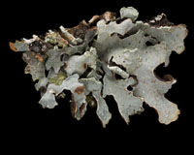
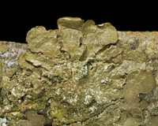
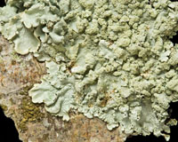
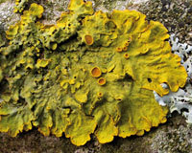
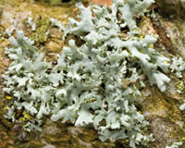
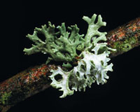
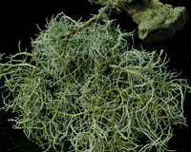
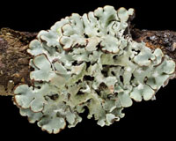
What do our air-monitor lichens look like?
Crustose Lichens
Fruticose / foliose Lichens
Parmelia family – brown, yellow-green and grey-green leafy lichens – have short hairs on their underside
Xanthoria – orange leafy lichens
Physcia – with longish hairs on the edges
Evernia - Green top & White underside
Usnea – like a wirey beard
Hypogymnia – a puffy lichen with no hairs

Slide 8
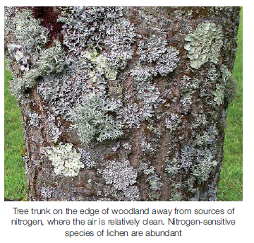
What do the results mean?
Places with clean air have more pollution sensitive bushy lichens (e.g. Usnea and Evernia)
Places that have a lot of nitrogen will have a lot of the orange leafy lichens (Xanthoria)
Places that have quite clean air will have lots of the green and brown leafy lichens (Parmelias)
If both are growing together then the air might be changing

