Slide 1
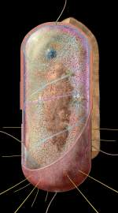

Bacteria
General characters, Ultra structure, Classification based on shape,
Reproduction, Economic importance
Dr. Shinde A. S.
Department of Botany
Shri Chhatrapati Shivaji College,Omerga

Slide 2
Introduction
Bacteria are omnipresent.
They are found in all environments, where organic matter is present.
Some of the bacteria live as commensals (e.g. Escherichia coli in the human intestine) and some live as symbionts (eg. Rhizobium) in the root nodules of leguminous plants.
Several of them cause diseases in plants, animals and human beings.
Bacteria are very small, most being approximately 0.5 to 1 micron in diameter and about 3 to 5 microns in length

Slide 3
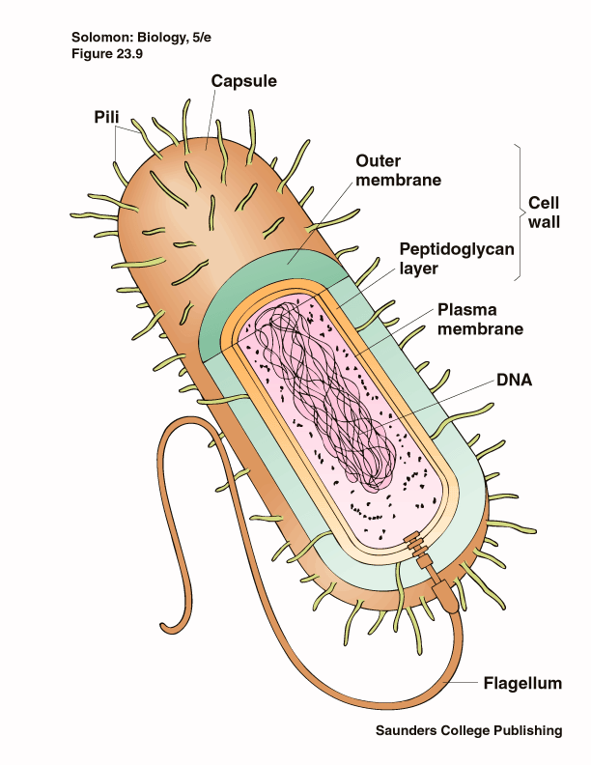
Prokaryotes
Cells that do not have a nucleus
Exist almost every where on earth
Grow in numbers so great you can see them with the unaided eye
Are placed in either the Eubacteria or the Archebacteria Kingdoms
Make up the smaller of the two kingdoms

Slide 4
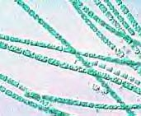
Eukaryotes
Make up the larger of the two prokaryote kingdoms
Generally are surrounded by a cell wall composed of complex carbohydrates

Slide 5
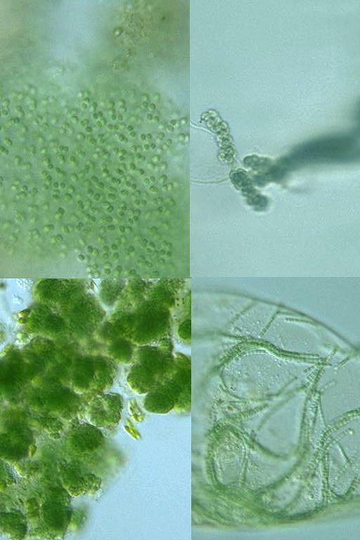
Cyanobacteria
Photosynthetic bacterium
Bluish-greenish color
Contain membranes that carry out the process of photosynthesis
Do not contain the same type of chloroplasts as plants do
This bluish-greenish algae can be found nearly everywhere on earth.
Can survive in extremely hot environments and even extremely cold environment

Slide 6
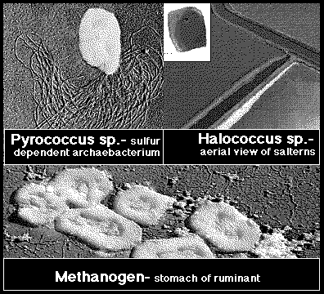
Archaebacteria
Lack important carbohydrate found in cell walls
Have different lipids in their cell membrane
Different types of ribosomes
Very different gene sequences
Archaebacteria can live in extremely harsh environments
They do not require oxygen and can live in extremely salty environments as well as extremely hot environments.

Slide 7
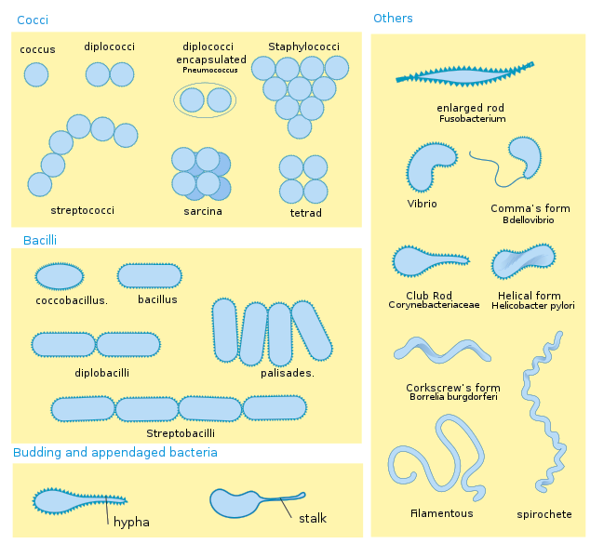
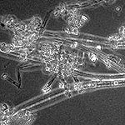
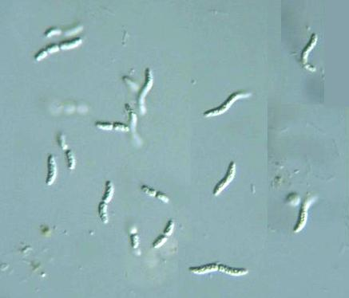
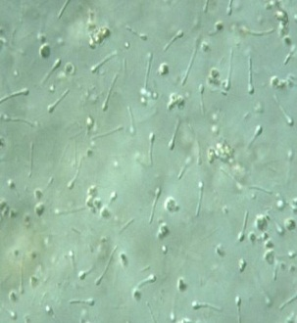
Classification of bacteria

Slide 8
Flagella in Bacteria

Slide 9
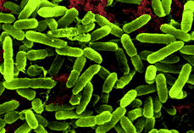
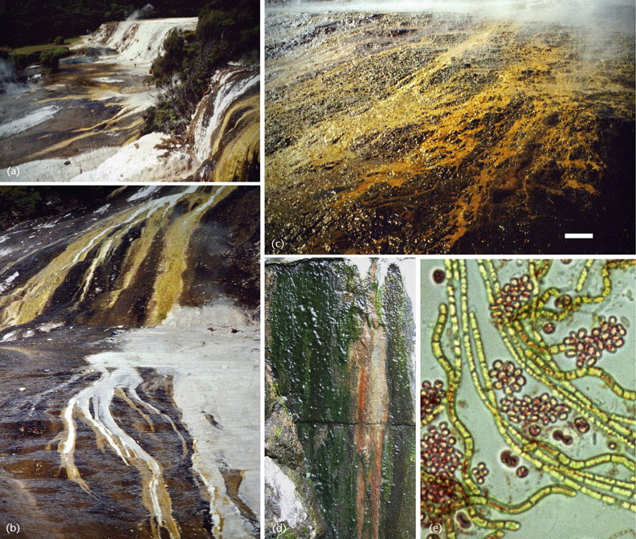
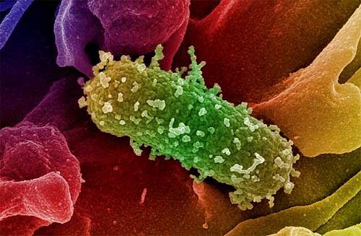
Nutrition
Autotrophs
Make their own energy
Using Solar energy
Eg. Cyanobacteria
Chemotrophs
Make own Energy
Using Chemical energy
Eg. Archaebacteria
Hetertrophs
Obtain food
By eating
Eg. E-coli

Slide 10
Bacteria Respiration
Obligate Anaerobes
Facultative Anaerobes
Obligate Aerobes
Live without Oxygen
Can live with or without oxygen
Cannot live without oxygen.

Slide 11
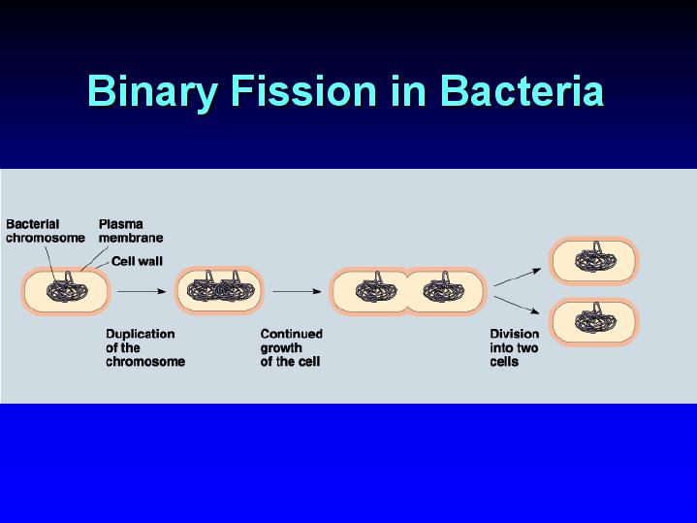
Reproduction
Cellular organism copies it’s genetic information then splits into two identical daughter cells

Slide 12
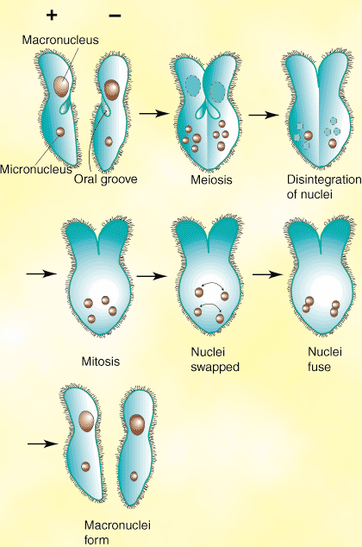
Reproduction
Conjugation
A type of Bacteria Sex
Two organism swap genetic information, that contains the information such as a resistance to penicillin

Slide 13
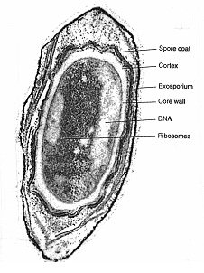
Reproduction
A type of dormant cell
Exhibit no signs of life
Highly resistant to environmental stresses such as:
-High temperatures
-Irradiation
-Strong acids
-Disinfectants
Endospores are formed by vegetative cells in response to environmental signals that indicate a limiting factor for vegetative growth, such as exhaustion of an essential nutrient.

Slide 14
Economic Importance
1. Diseases caused by bacteria in plants:
Host Disease Causal Pathogen
Citrus Citrus Canker Xanthomonas citrii
Rice Bacterial blight Xanthomonas oryzae
Cotton Angular leaf spot Xanthomonas malvacearum
Pears Fire blight Pseudomonas solanacearum
Carrot Soft rot Erwiinia caratovora
2. Diseases caused by bacteria in animals :
Sheep Anthrax Bacillus anthracis
Cattle Brucellosis Brucella abortus
Sheep,goat Brucellosis Brucella melitensis
3. Diseases caused by bacteria in human beings:
Cholera Vibrio cholerae
Typhoid Salmonella Typhi
Tuberculosis Mycobacteriam tuberculosis

Slide 15
Economic Importance
Sewage disposal
Decomposition of plant and animal remains
Soil fertility
Recycling of matter
Dairy Industry
Lactic acid bacteria Streptococcus lactis
Convert milk into curd, yoghurt (Lactobacillus bulgaricus) and cheese (Lactobacillus acidophobus).
Vinegar Acetobactor aceti
Alcohols and Acetone
Curing of tobacco, tea and coffee
Retting of fibers
Antibiotics
Vitamins
B. thuringiensis infect and kill the caterpillars of some butterflies and related insects.

