Slide 1
Viruses General characters, classification based on host, economic importance, TMV – structure and multiplication
Dr. Shinde A. S.
Department of Botany
Shri Chhatrapati Shivaji College, Omerga

Slide 2
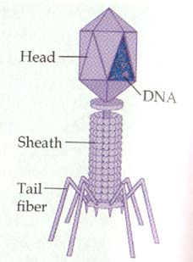
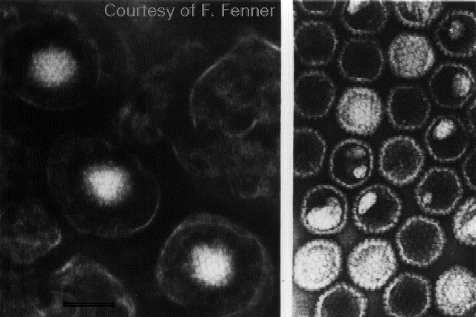
What is virus?
Virus
The smallest infectious and acellular microbe
consisting only one kind of nucleic acid (DNA or
RNA), and which obligately replicate inside host
cells.
Virion
The complete mature viral particles.
(The intact infectious virus particles.)

Slide 3
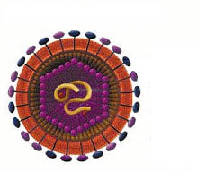
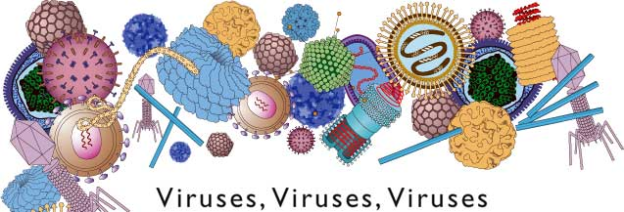
Distinctive Features
Acellular submicroscopic microbes
Pass through 0.2μm filters
Obligatory intracellular parasites.
Contain either DNA or RNA
Self-replication with host
machinery

Slide 4
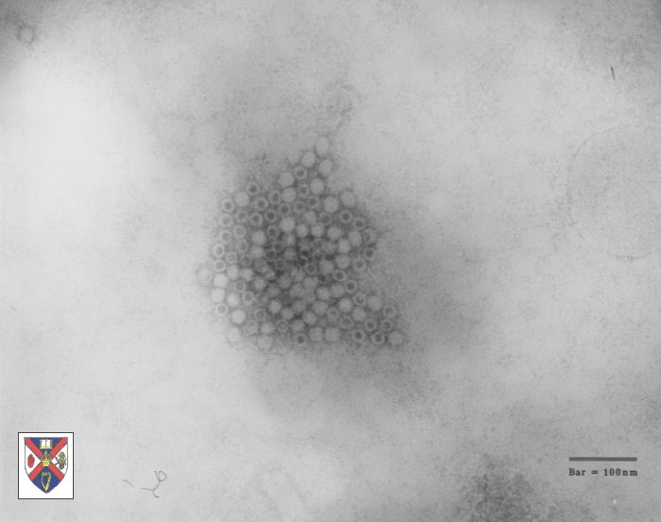
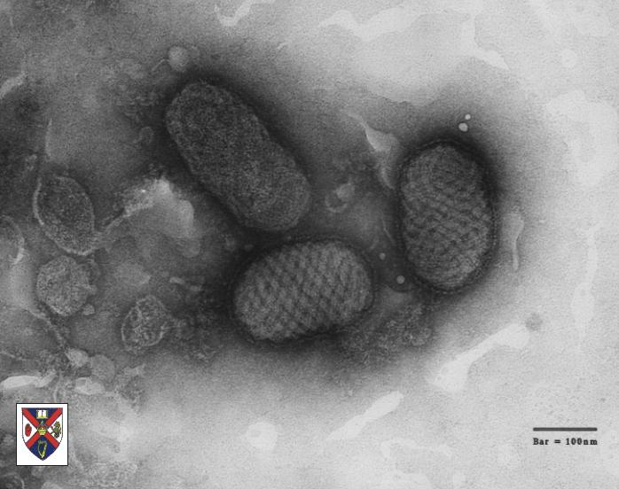
Size, Shape and Structure
Size of Viruses
Parvoviruses
Poxviruses

Slide 5
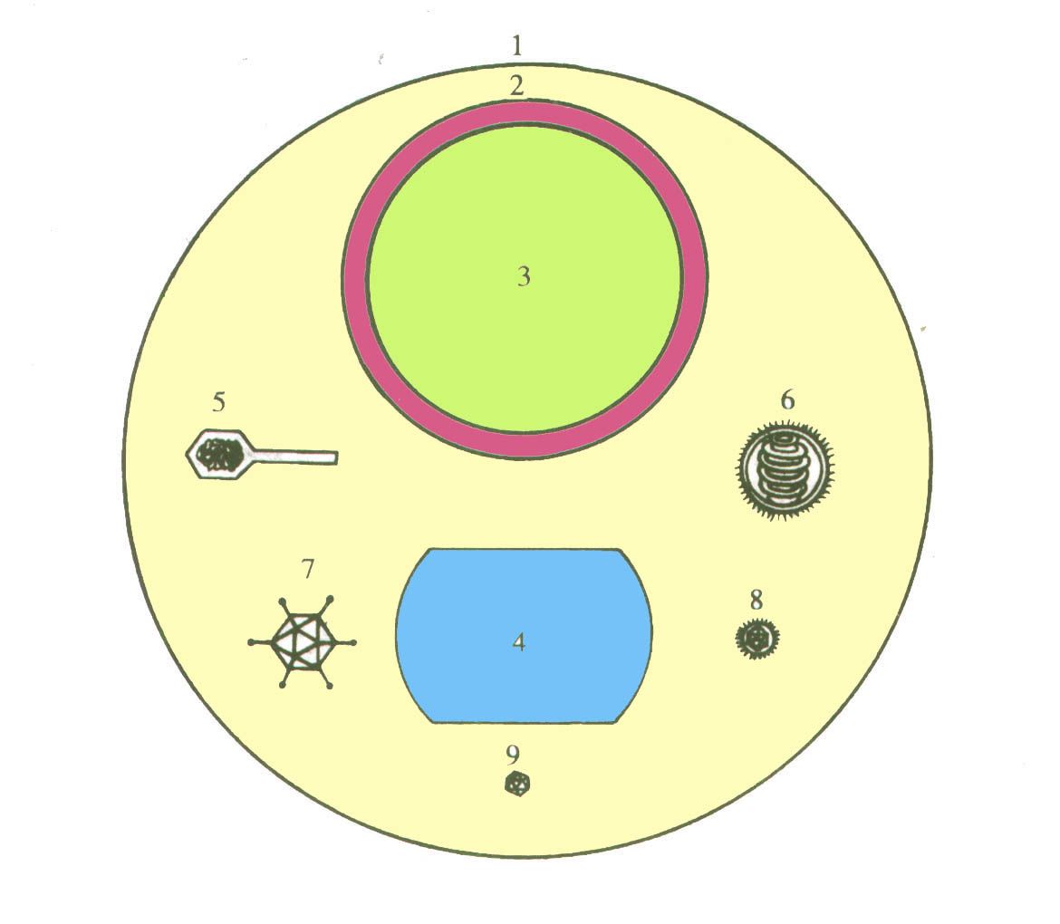
Comparative Sizes of Virions and Bacteria
1. Staphylococcus aureus
2. Rickettsia
3. Chlamydia
4. Poxviruses
5. Bacteriophage of E. coli
6. Influenza virus
7. Adenovirus
8. Encephalitis B virus
9. Poliovirus

Slide 7
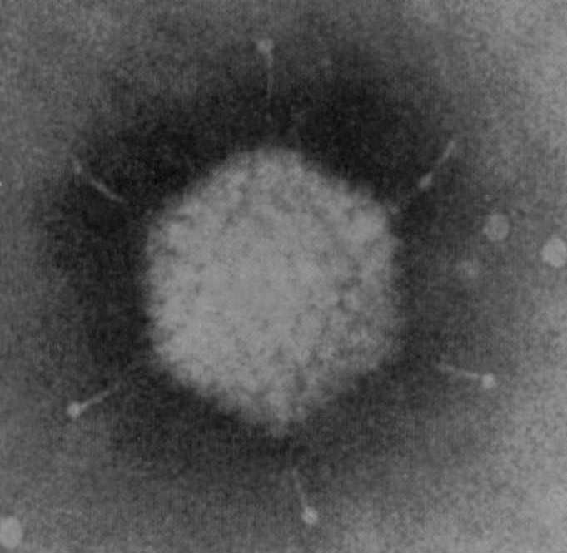
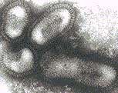
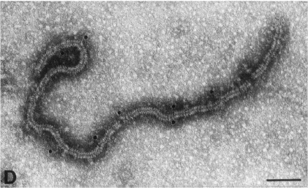
Size, Shape and Structure
B. Shape:

Slide 8
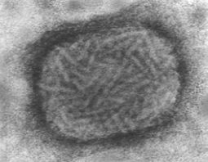
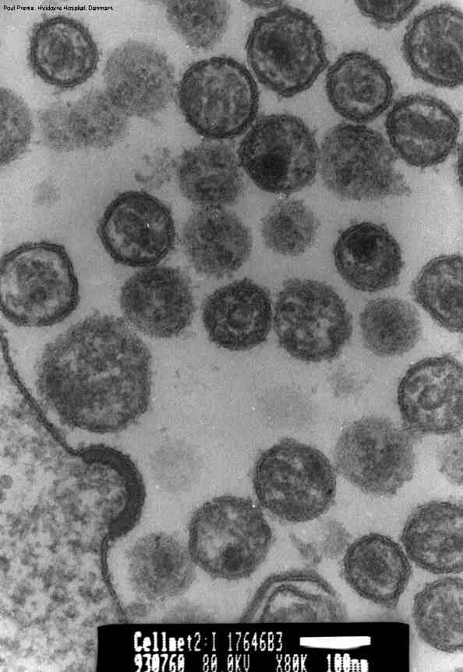
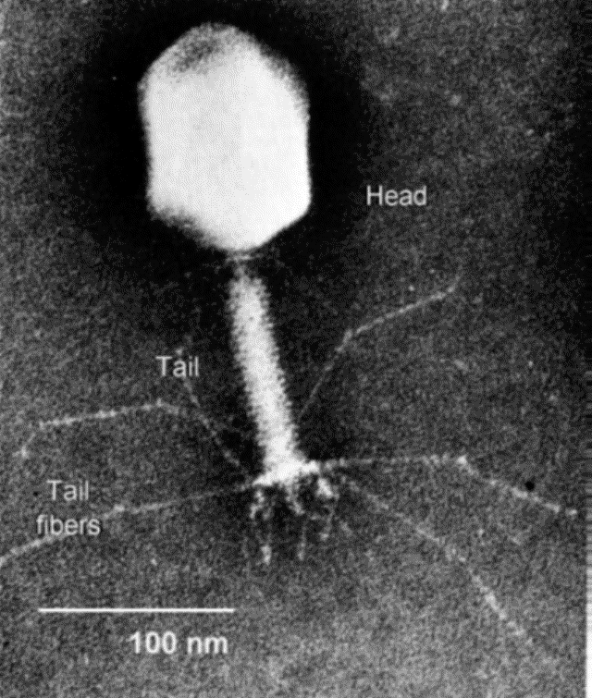
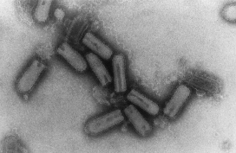
Tobacco Mosaic Virus (TMV): Rod-Shaped
Poxvirus: Brick-Shaped
VSV- Vesicular Stomatitis Virus
- Bullet-Shaped
HIV - Spherical
Bacteriophage T4: Tadpole-shaped

Slide 9
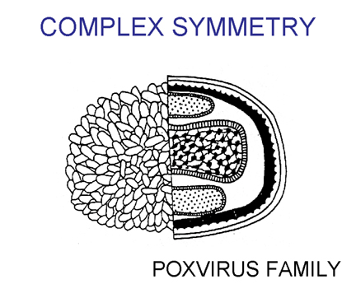
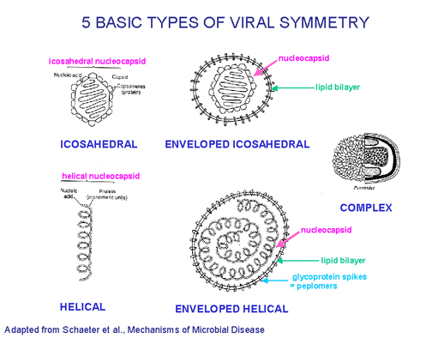
Influenza Virus
Symmetry of viral nucleocapsids
is decided by arrangement of capsomeres
Helical symmetry
(e.g., tobacco mosaic virus)
Icosahedral symmetry
(e.g., adenovirus)

Slide 10
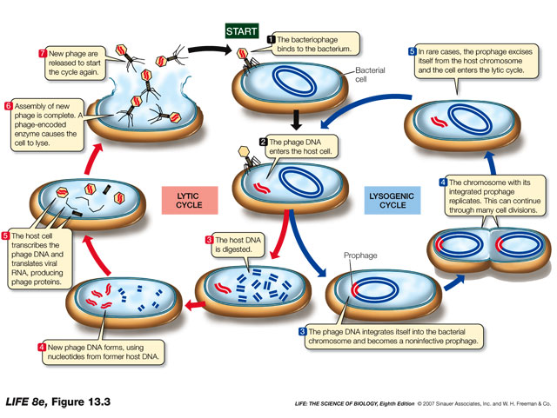
Lytic Cycle

Slide 11
Economic Importance of Viruses
Significance of Viruses
Viruses are a kind of biological puzzle to biologists since they are at the thresh hold of living and non-living things showing the characteristics of both.
Viruses are very much used as biological research tools due to their simplicity of structure and rapid multiplication. They are widely used in research especially in the field of molecular biology, genetic engineering, medicine etc.
Viruses are used in eradicating harmful pests like insects. Thus they are used in Biological Control Programmes.
Plant Viruses cause great concern to agriculturists by their pathogenic nature. Bacteriophages attack the N2 fixing bacteria of soil and are responsible for reducing the fertility of soil.
In industry, viruses are used in preparation of sera and vaccines.

Slide 12
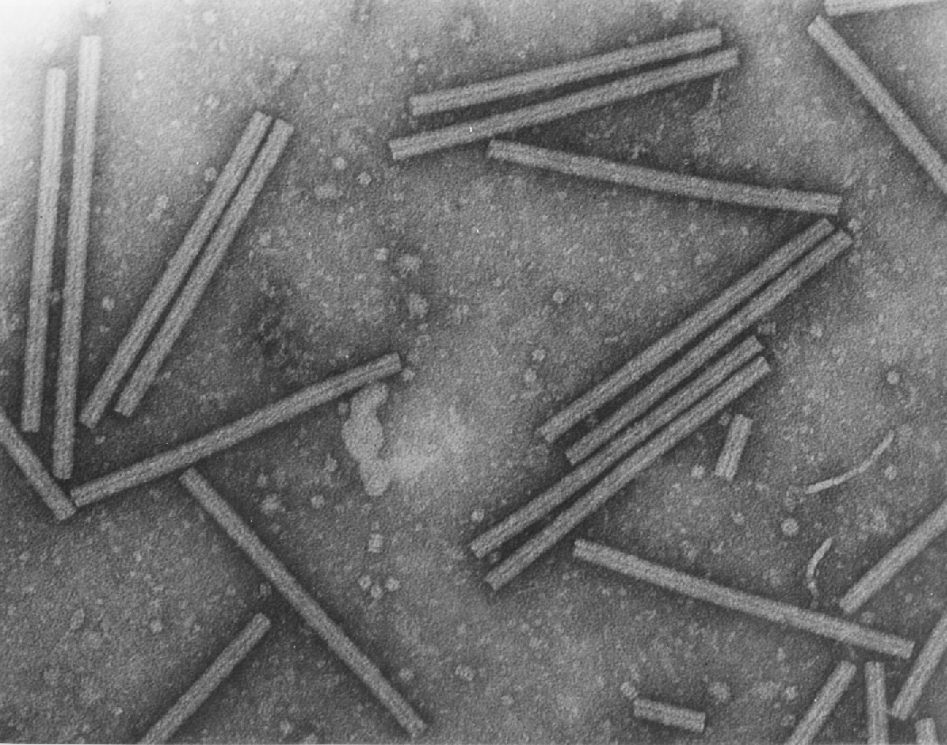
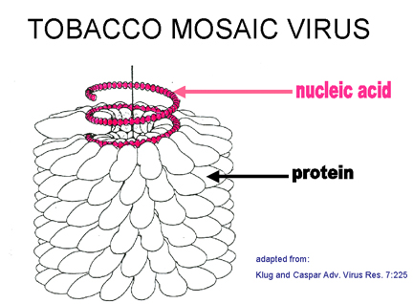
Tobamovirus Tobacco Mosaic Virus (TMV)
Tobacco mosaic virus (TMV) is a positive-sense single stranded RNA virus that infects plants, especially tobacco and other members of the family Solanaceae. The infection causes characteristic patterns (mottling and discoloration) on the leaves (hence the name).
It was discovered by Ivanowski in 1892 this was the 1st virus to be purified in a crystalline form in in 1936 by W. M. Stanley.

Slide 13
Replication
When it enters the host, its RNA directs the synthesis of viral proteins by the host machinery.
After the RNA and the protein is produced, they undergo self-assembly. After the assembly of capsomeres and RNA, they are released outside the cell after the lysis and death of the host.
Then the viral genome will further replicate to produce multiple mRNAs. Thus TMV can replicate its own genome.
As the rod lengthens, the RNA passes through a channel in its center and forms a loop at the growing end. In this way the RNA can easily fit as a spiral into the interior of the helical capsid.
When TMV infects a tobacco plant it enters its cell and gets replicated.
For its smooth entry TMV produces a 30,000 Dalton protein called P30 which tends to enlarge the plasmodesmata and allows their free entry to the neighboring cells

Slide 15
Thank you!

